Slide 2
Outline
Introduction
Hardware Components
Sensors
Actuators
IO Interfaces
Processor Complex or SoC
Processor and IO Interconnection
Bus Interconnection
High-Speed Serial Interconnection
Low-Speed Serial Interconnection
Interconnection Systems
Memory Subsystems
Firmware Components
Boot Code
Device Drivers
Operating System Services

Slide 3
Introduction
The System design can be approached in a bottom-up or a top-down fashion
The bottom-up approach consists of determining the fundamental components that go into a system
The top-down approach is a hierarchical breakdown of the system into subsystems and then into components (Macro Level)
The top-down approach can be viewed as a concrete breakdown of the system into smaller parts as suggested (Micro Level)
An abstract top-down approach is useful where the system is broken down by service and function
Example: Real-time embedded system can be viewed as a hierarchy of subsystems, (real-time stereo-vision tracking system)

Slide 4
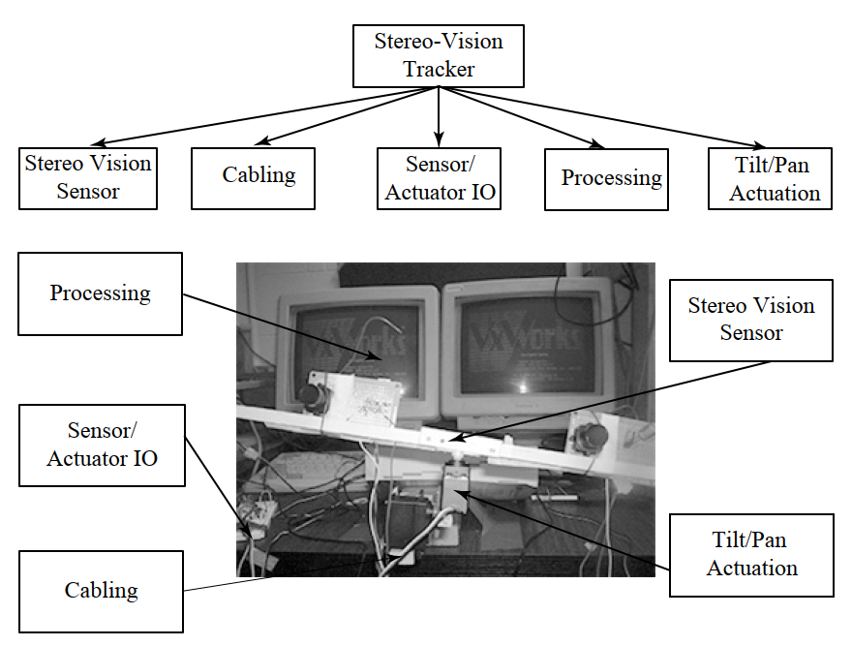
Introduction (Contd.)
Fig. Subsystems in a Stereo-Vision Tracking System

Slide 5
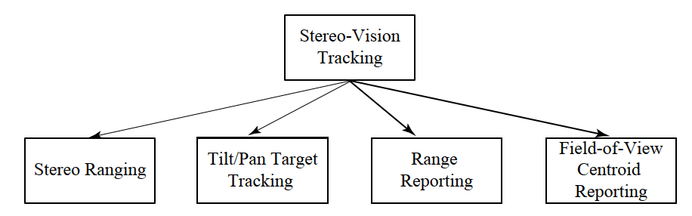
Introduction (Contd.)
The stereo-vision tracking system has a simple goal—keep a bright object in the field of view of both cameras even if the object moves and estimate the distance from the camera assembly to the object
A more functional service view of the same stereo-vision tracking system would look much different
Fig. Services in a Stereo-Vision Tracking System

Slide 6
Hardware Components
The hardware components of a real-time embedded system will include a wide range of components that are mechanical and electrical
For example, in the stereo-vision tracking system we have:
Structural and mechanical—camera assembly
Electromechanical actuators—tilt and pan servos
Electromechanical sensors (transducers)—none, but servo position sensors could be added
Optical sensors—National Television Standard Committee (NTSC) cameras
Cabling—power, NTSC signal, RS232, CAT-5 twisted pairs
Digital state machines, microcontrollers, and microprocessors—x86 microprocessor, PIC microcontroller
Analog front-end (sensor) and back-end (actuator) circuits—NTSC, TTL pulse-width modulation
Networks or bus interfaces—RS232 serial, Ethernet, PCI
Thermal management—CPU fan

Slide 7
Hardware Components (Contd.)
Typically additional test equipment hardware may also require including monitors, development computing environment, oscilloscope, digital multimeter, and a logic analyser
However, these are not part of the system, although required to fully implement and verify its proper implementation and operation

Slide 8
Hardware Components (Contd.)
Sensors
Sensors are devices that respond to physical stimulus (light, heat, pressure, stress/strain, acceleration, magnetism) by transforming the associated energy into electrical energy
Example
A camera is a sensor that converts photon energy into electrical charge that represents the photon flux for each picture element in an array
A thermistor is a resistor circuit where the resistance of the thermistor changes with temperature, and therefore so does the circuit current at a given voltage and voltage drop across the load
A sensor assembly may also interface this analog front end to a digital encoding interface
The Analog-to-digital converters (ADCs) are used to sample and hold charge, thereby converting the analog circuit current/voltage into a digital value

Slide 9
Hardware Components (Contd.)
Sensors
The Real-time embedded systems therefore require digital encoding of all sensor inputs, with the exception of subsystems, which are all analog
The sensor AFE (Analog Front End) involves physics that are very particular to the environmental phenomena being sensed and the method for generating measurable changes in an analog circuit based upon physical stimulus
Many sensors are electromechanical devices where mechanical stimulus, such as stress/strain, the force per unit area and resulting deformation, or motion, causes a change in analog circuit voltage/ current.
Resistance in many materials is a function of stress, strain, and/or temperature; thus these mechanical properties can be measured using the right material as a resistor in a circuit in the AFE
Motion can be sensed also with a variation of resistance through potentiometers, where resistance is modified by mechanically varying the resistive path in a circuit

Slide 10
Hardware Components (Contd.)
Sensors
The sensor always includes the AFE, but may also include the analog-to-digital encoding as well
In the case of an NTSC (National Television Standards Committee) camera, the camera outputs an analog signal that encodes photo-intensity in an image field of view in an analog raster output
The NTSC analog signal can be further encoded from the NTSC signal into a digital image, which is an array of alpha-RGB (Red, Green, Blue) pixels that indicate luminance and chrominance of subareas of the camera’s field of view—picture element or pixel alpha-RGB values encoded using an ADC
This is the approach taken in the stereo-vision example. An alternative might employ a CCD (Charge Coupled Device) camera, which provides a more direct encoding of photo-intensity (photon flux) in terms of electrical charge

Slide 11
Hardware Components (Contd.)
Sensors
The ADC implementation has significant impact on the encoding capability, including the following:
Sampling frequency
Sample accuracy
Input range
The ADC takes an analog input (voltage or current) and converts it into a digital word, most often from 8-bit to 16-bit.
8-bit ADC can represent only 256 distinct values
16-bit ADC represents 2¹⁶ i.e., 65656 distinct values

Slide 12
Hardware Components (Contd.)
Actuators
An actuator is a transducer that converts electrical energy into some other form, such as sound, motion, heat, or electromagnetism
A servomechanism, or servo, is an actuator that converts electrical energy into mechanical rotation, using a motor and a control interface
The heating elements that are simple resistors can be modulated to provide heat for a system that requires minimum operating temperatures
Likewise, for systems that require active cooling, actuator subsystems can provide cooling using fans, louvers, or some other form of conductive, convective, or radiative cooling
The digital values are decoded into analog signals through an analog back end (ABE) for actuation so that a digitally encoded value drives the voltage in the ABE circuit

Slide 13
Hardware Components (Contd.)
Actuators
This is most often done using either PWM (Pulse-Width Modulation) or a DAC (Digital-to-Analog Converter) so that the amplitude in the ABE can be driven by a stream of digital encoded outputs
With PWM, a periodic digital pulse is driven out with a duty cycle that is proportional to the desired amplitude of the signal at a given point in time
The DAC provides the proportional output automatically based upon the last commanded digital output rather than decoding using a digital duty cycle
Much like ADC sensor interfaces, DAC actuator interfaces should be characterized by the following:
Type of actuation—on/off or DAC/PWM modulated
Speed of actuation
Accuracy of modulation

Slide 14
Hardware Components (Contd.)
Actuators
Most often for accurate high-rate actuators, a DAC is required rather than relays or PWM. For audio output, PCM (Pulse Code Modulation) is used for input sampling and driving an output DAC for duration and at variable output levels
Actuators can be very unstable and suffer overshoot or failure to settle without careful design and potential feedback from sensors
Some of the high-rate feedback control for such an actuator might be implemented as a traditional analog control circuit rather than relying upon the digital real-time embedded system to provide such control.

Slide 15
Hardware Components (Contd.)
IO Interfaces
IO interfaces are the communication mediums, used to transfer the information from External device to internal devices and vice-versa
The IO in general to and from a real-time embedded system can be classified first as either analog or digital
In the case of analog IO, an ADC is required to encode analog inputs and a DAC, PWM, or relay interface is required to decode digital outputs when analog IO is interfaced to a real-time embedded system
Many embedded systems may actually be subsystems in a much larger system and therefore may not actually have direct analog IO—instead, many real-time embedded systems have digital IO only or in addition to analog IO
Either way, at some point, all IO becomes digital once encoded or prior to decode. So, prior to the ABE or after the AFE, the embedded system simply sees digital IO

Slide 16
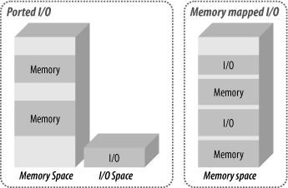
Hardware Components (Contd.)
IO Interfaces
The form of the digital IO, however, can vary significantly and can be characterized as:
Word-at-a-time IO
Block IO
Furthermore, the method of interfacing word or block IO can be:
Memory Mapped IO
Port IO

Slide 17
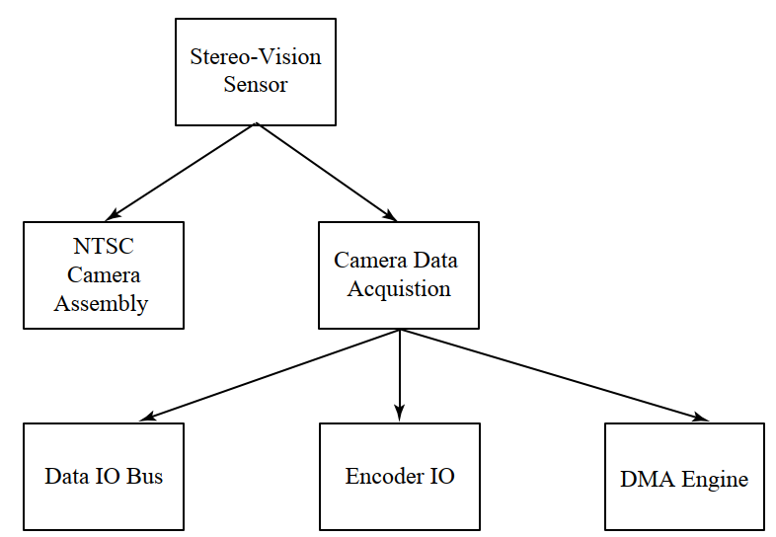
Hardware Components (Contd.)
IO Interfaces
The Figure shows the components of the stereo-vision sensor subsystem for the stereo-vision tracker
This sensor device consists of two NTSC cameras and two Peripheral Component Interconnect frame grabbers
The data acquisition is composed of an NTSC signal encoding interface, a PCI bus data IO DMA channel, and a programmable DMA engine
The encoding is performed at 30 frames per second for a selection of video-encoding formats, including the maximum resolution of 640x480 32-bit pixels
Figure. NTSC Vision Subsystem in Stereo-Vision Tracking System

Slide 18
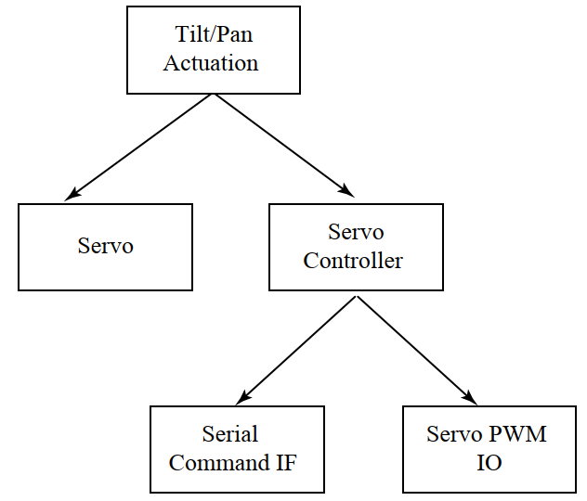
Hardware Components (Contd.)
IO Interfaces
The DMA engine is a simple processor with an RISC instruction set that provides control over the encoding as well as the PCI DMA transfer and generation of host interrupts
The stereo-vision tracker also incorporates a low-rate actuation IO interface to enable the system to tilt and pan the stereo-vision sensor (cameras and baseline mount) to follow a bright target that may be moving in order to keep the target in both camera fields of view
The tilt/pan actuation subsystem uses two servos to provide the tilt and pan rotational degrees of freedom
Figure. Tilt/Pan Servo Subsystem in
Stereo-Vision Tracking System

Slide 19
Hardware Components (Contd.)
Processor Complex or SoC
Almost all modern real-time embedded systems include a general purpose CPU to process firmware/software to provide updateable and flexible services by processing and linking sensor inputs to actuator outputs
If the services that a real-time embedded system must provide are so well known that they can be fully committed to a hardware state machine, then perhaps a processor complex (or set of interconnected CPUs or CPU cores) is not needed
The processor complex may be composed of the following:
A single CPU with port IO and bus interface Memory Mapped IO (MMIO)
Multiple CPUs on an internal bus with port/MMIO
Multiple CPUs with an interconnection network and port/MMIO
An SoC (System on a Chip) with multiple CPU cores interconnected on-chip with memory, IO, flash, and any number of peripherals making it a single-chip solution

Slide 20
Hardware Components (Contd.)
Processor Complex or SoC
In the case of our working example, the stereo-vision system, a main x86 CPU provides an image processing platform to compute the centroid of the target object as seen by the left and right cameras and encoded using the Peripheral Component Interconnect-bus NTSC encoder subsystem
The servo control is achieved using the Servo Controller, a Microchip PIC that commands multiple servos to tilt/pan the camera assembly using TTL logic-level PWM based upon a serial byte stream command to the controller
The Figure shows the subsystems (Servo Control and Image Processing) that compose the overall stereo-vision system processing to provide the tracking and ranging services
The Servo Control subsystem uses a digital control law based upon calculated centroid inputs to tilt/pan the stereo-vision sensors in real time to keep the target in the field of view and produces a series of servo commands as output
The Image Processing subsystem uses alpha-RGB video frames at a maximum rate of 30 fps to compute the centroid of the target as seen by each camera and the range to the target based upon a triangulation calculation

Slide 21
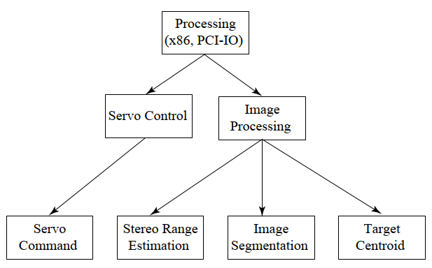
Hardware Components (Contd.)
Processor Complex or SoC

Slide 22
Hardware Components (Contd.)
Processor and IO Interconnection
For multi-CPU real-time embedded systems, an interconnection network is required to enable IO and processing to be distributed
The interconnection network can be
Simple bus (e.g., PCI or VME)
On-chip local bus with bus interface unit to back-plane IO bus
A crossbar on-chip interconnection between CPUs
An off-board network—for example, firewire, USB, Ethernet
The Figure shows taxonomy for interconnection strategies that can be used to integrate CPUs and IO interfaces in an embedded system
Most embedded systems are integrated with a scalable bus architecture, point-to-point serial links, or networks

Slide 23
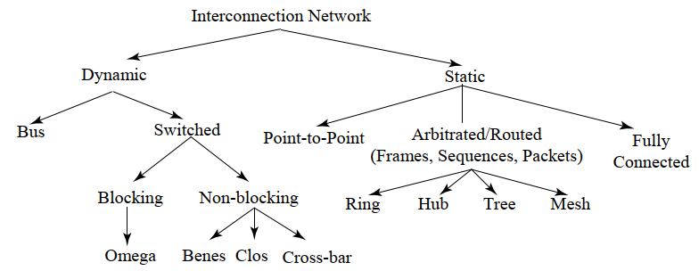
Hardware Components (Contd.)
Processor and IO Interconnection
Figure. Taxonomy of Processor-IO interconnection Strategies

Slide 24
Hardware Components (Contd.)
Bus Interconnection
BUS: A bus is a high-speed internal connection. Buses are used to send control signals and data between the processor and IO Devices
Many different bus architectures have been used and are being used for embedded systems
ISA (Industry Standard Architecture): is one of the oldest buses still in use. Even though it’s been replaced with faster buses, ISA still has a lot of legacy devices that connect to it like cash registers, Computer Numerical Control (CNC) machines, and barcode scanners
The PCI (Peripheral Component Interconnect) bus, introduced as a replacement for the ISA
A goal of the first PCI standard, 2.1, was to provide a bus where IO could be interfaced to processor complexes with plug-and-play integration
The PCI bus was designed to integrate with the legacy ISA bus through an interface called the South Bus

Slide 25
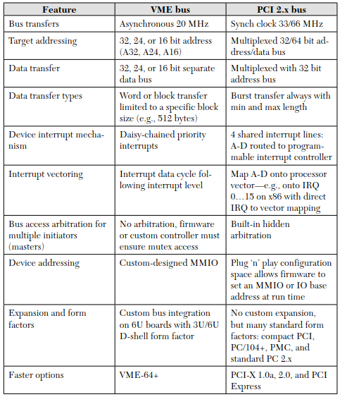
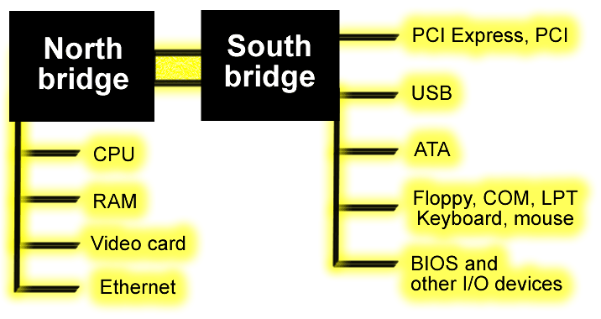
Hardware Components (Contd.)
Bus Interconnection
At the time that PCI was first introduced, many embedded systems were integrated using the VME bus (Versa Local Bus Module Expansion)
The stereo-vision systems implemented at the University of Colorado using PCI 2.1 have had no problem making use of PCI 2.1 for this application with a 320 × 240 30 fps alpha-RGB encoding

Slide 26
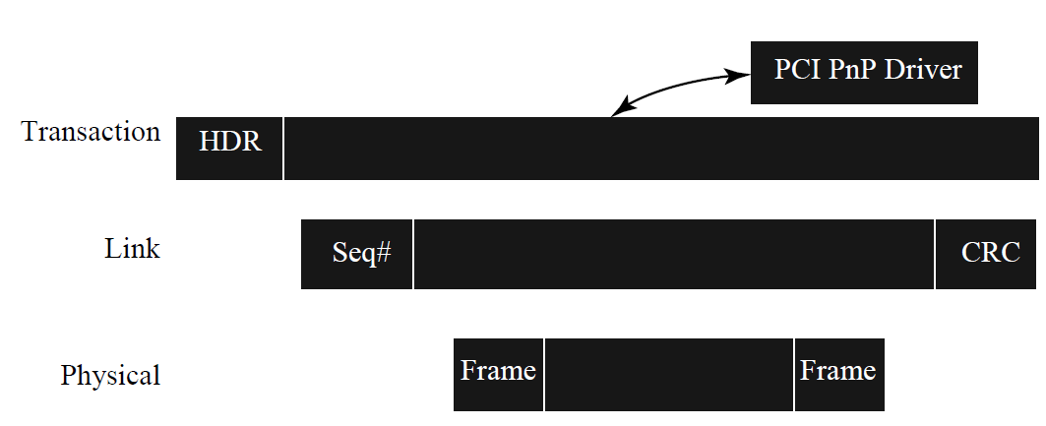
Hardware Components (Contd.)
Bus Interconnection
Figure. PCI Express Byte Lane Network Architecture
HDR- Header
Seq-Sequence Number
CRC- Cyclic Redundancy Check
PnP- Plug and Play Driver

Slide 27
Hardware Components (Contd.)
High Speed Serial Interconnection
As traditional back-plane buses have become problematic as far as laying out signal traces and dealing with high-speed signaling and skew (rates above 100 MHz)
Several new high-speed serial interconnection standards were introduced, including:
Universal Serial Bus (USB)
USB is a plug and play interface that allows a computer to communicate with peripheral and other devices
Firewire
FireWire, also called IEEE 1394, high-speed computer data-transfer interface that was used to connect personal computers, audio and video devices, and other professional and consumer electronics
PCI Express
A new protocol called PCI Express (PCIe) eliminates a lot of these shortcomings, provides more bandwidth and is compatible with existing operating systems

Slide 28
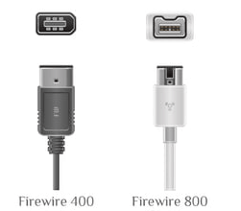
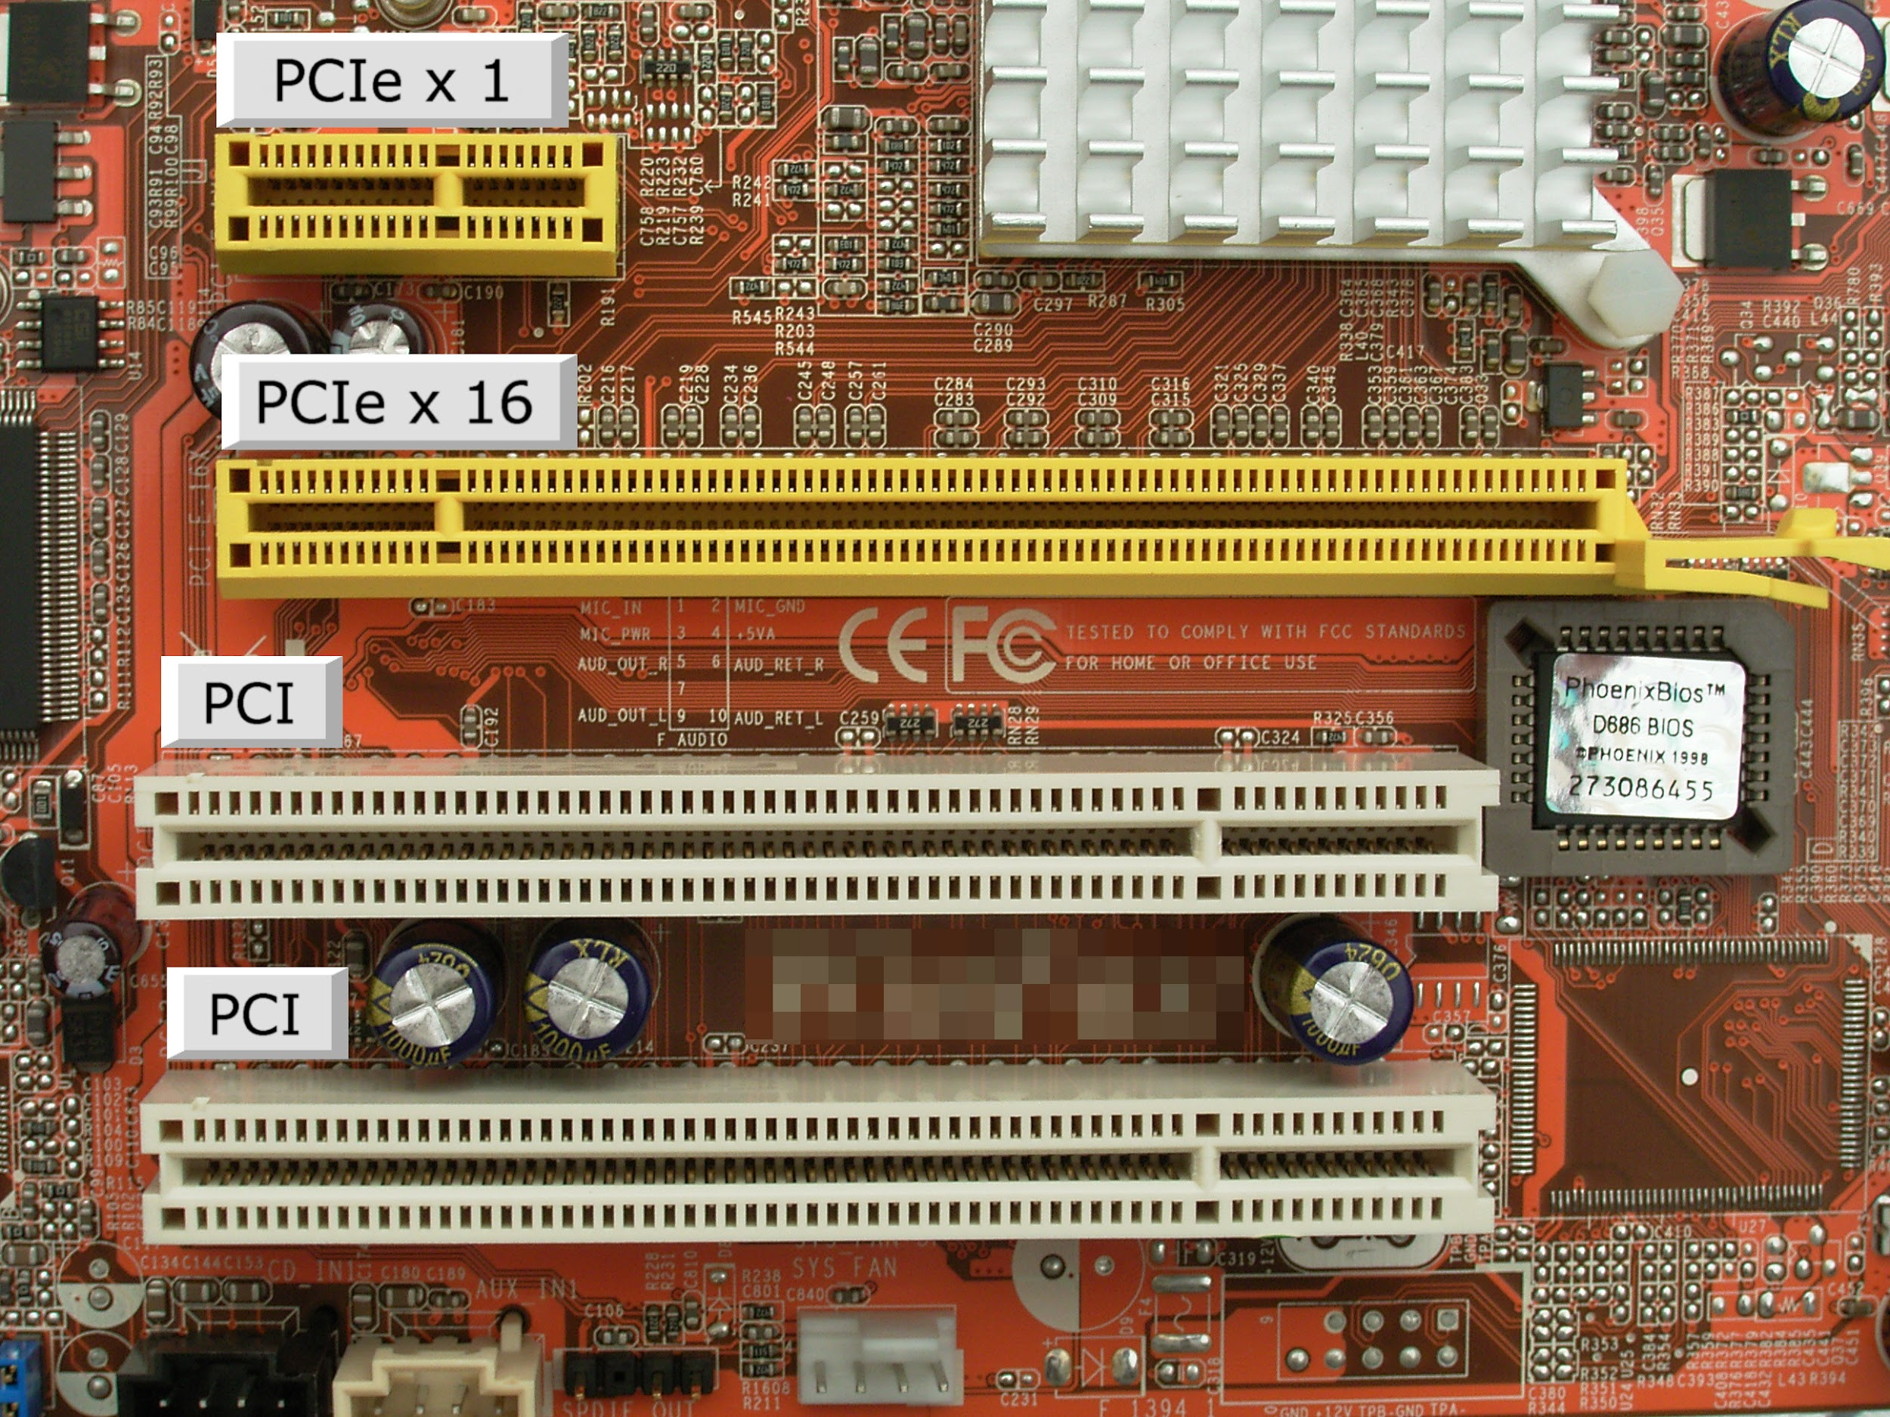
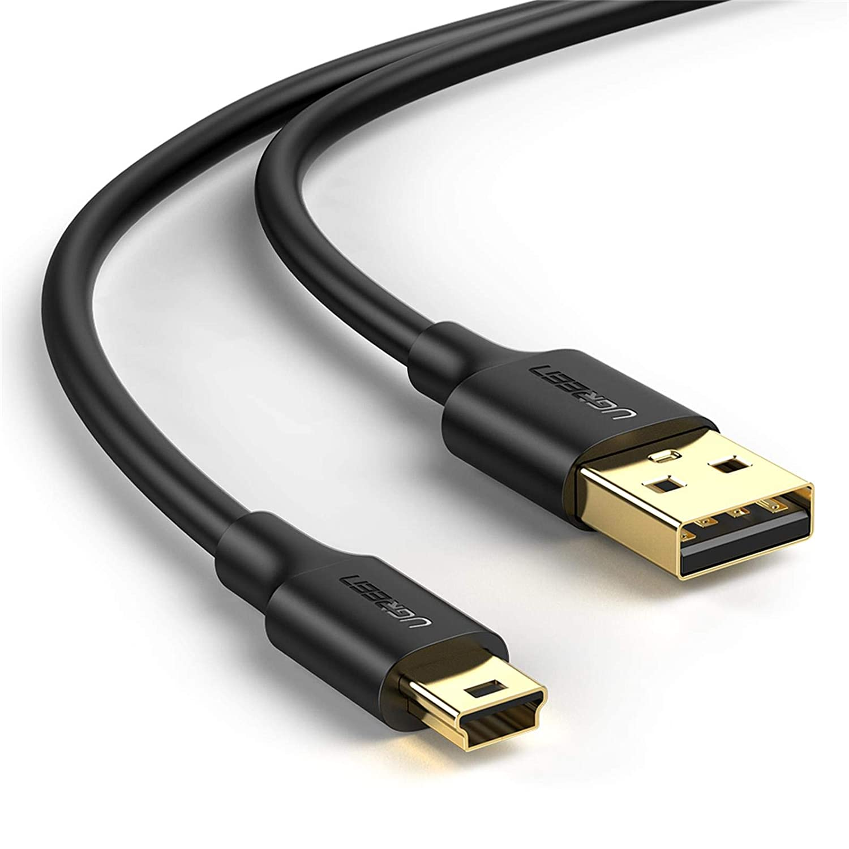
Hardware Components (Contd.)
High Speed Serial Interconnection
Gigabit Ethernet
In computer networks, Gigabit Ethernet (GbE) is the family of Ethernet technologies that achieve theoretical data rates of 1 gigabit per second (1 Gbps)

Slide 29
Hardware Components (Contd.)
High-Speed Serial Interconnection
One important feature of PCI is that initiators can configure targets for a maximum and minimum burst length
The minimum serves as a method to reduce overhead so that targets can’t transfer small blocks that would incur high overhead for each bus-arbitration and address cycle compared to fewer larger block transfers
The maximum prevents a target from overusing the bus and provides some fairness in bus arbitration for multi-target systems.

Slide 30
Hardware Components (Contd.)
Low-Speed Serial Interconnection
Many real-time embedded systems include not only high-rate IO for services such as video or network transport but also low-rate command/response or monitoring interfaces
For example, in our stereo-vision system, the servos are commanded through a low-rate multi-drop RS232 interface
The RS232, common serial, point-to-point data transmission has been used in real-time embedded systems since the advent of the industry and remains a common low-rate and debug interface
The RS232 link normally tops out around 115,200 bits/second (about 12 KB/sec) and is not capable of long-distance transmission due to line noise at the 12-volt signaling levels it uses
Other options have evolved that provide similar low- to medium-rate transmission with longer distance, multi-drop, and higher bit rates. These options are widely used in real-time embedded systems:

Slide 31
Hardware Components (Contd.)
Low-Speed Serial Interconnection
RS422—a differential +/- 5v serial link capable of 1 megabit/sec and distances up to 1 km
I2C (Inter Integrated Circuit)—a medium-speed digital interconnection typically used onboard to interconnect chips such as EEPROM to a processor
SPI (Serial Peripheral Interface)—a digital serial protocol capable of medium rates

Slide 32
Hardware Components (Contd.)
Memory Sub-Systems
Real-time embedded systems require nonvolatile data storage to boot the system and to start services
After a power-on, the processors in the processor complex each vector to a hardware-defined starting address to execute code after power-on reset, the processors in the processor complex each vector to a hardware-defined starting address to execute code
This starting address, typically a high address, such as 0xFFE0_0000, is designed to map a nonvolatile storage device, such as EEPROM or Flash memory, so that boot code can be stored permanently at this address and executed following a reset to initialize the system
The boot code initializes all basic interfaces and normally loads a basic RTOS so that application services can be loaded and run
The code (often called text segment), data (initialized, uninitialized, and read-only), heap, and stack segments must be created in a working memory by firmware.

Slide 33
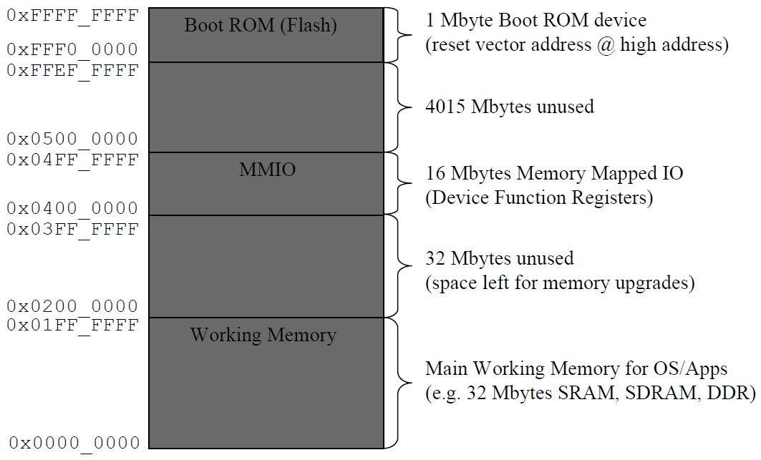
Hardware Components (Contd.)
Memory Sub-Systems
Figure. Typical Memory Map for an Embedded System

Slide 34
Hardware Components (Contd.)
Memory Sub-Systems
The memory map is really a logical view of memory from the viewpoint of address space through which firmware and software can access devices
From a hardware viewpoint, memory is better described as a hierarchy of storage devices, including:
Registers (CPU and memory mapped for device control)
Cache
Working Memory
Extended Memory

Slide 35
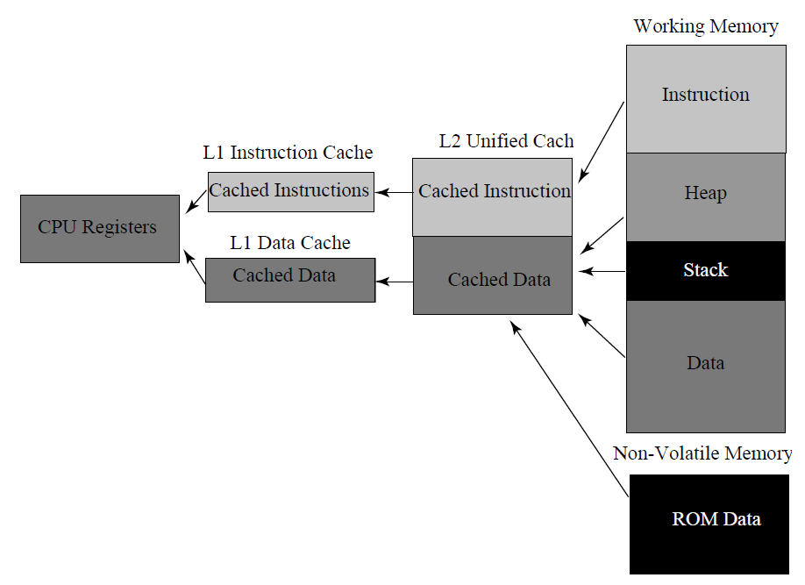
Hardware Components (Contd.)
Memory Sub-Systems
Common Physical Memory Hierarchy for an Embedded System

Slide 36
Firmware Components
Firmware is program that's embedded in a piece of hardware. You can think of it simply as “Software for Hardware." However, software is different from firmware, so the two are not interchangeable
Some components can be realized only in hardware, but many can be implemented with software or firmware (noting that software interfacing directly to hardware is typically called firmware)
Furthermore, if the real-time embedded system has any software-based services or even just management, firmware is needed to interface hardware resources to software applications

Slide 37
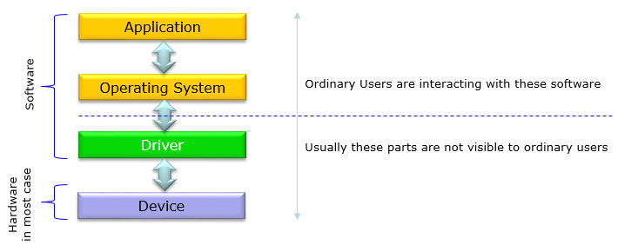
Firmware Components (Contd.)
BSP

Slide 38
Firmware Components (Contd.)
Boot Code
The universal definition of firmware is code or software that runs out of a nonvolatile device to make hardware resources available for the rest of the application software
Firmware providing this function is normally referred to in general as Board Support Package (BSP) firmware because traditionally this firmware has initialized and made available all onboard resources for a processor complex to software applications
Before the resources have been fully initialized, the firmware boots the board by executing code out of a nonvolatile device so that one or more basic interfaces are made operable and the system can now download additional application software
For example, the BSP boot firmware might initialize an Ethernet interface and provide TFTP download of application code for execution

Slide 39
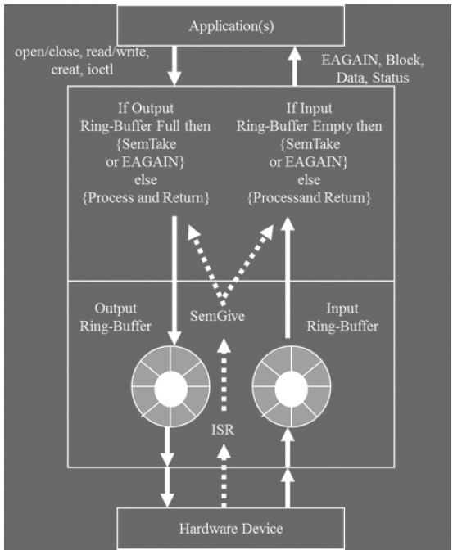
Hardware Components (Contd.)
Device Drivers
Generally called as Driver
A Device Driver is a software program that manages hardware components or peripherals attached to a computer and enables them to function with the computer smoothly
Device interface drivers are most often considered firmware because they directly interface to hardware resources and make those resources available to higher-level software applications
The architecture of a device driver interface is depicted in Figure and includes both an HW device interface and an SW application interface

Slide 40
Hardware Components (Contd.)
Operating System Services
Not all real-time embedded systems require an operating system
Most RTOS implementations do provide a layer of software that acts a single interface for all applications to gain access to system resources
Furthermore, most real-time systems incorporate an RTOS, which provides a framework for resource management and for scheduling processor resources
The RTOS also provides commonly needed services and libraries used by application services
The most fundamental services and mechanisms provided include the following:
Priority pre-emptive scheduler for threads
Thread control block management
Inter-thread synchronization and communication (e.g., semaphores and message queues)
Basic IO for system debug and bring-up (e.g., serial, Ethernet, LED)
Interrupt service routine installation on interrupt vectors

Slide 41
Hardware Components (Contd.)
Operating System Services
Transition from boot to operational state
Timers for delays and blocked thread timeouts
Drivers for basic hardware devices (serial, Ethernet, timers, non-volatile memory)
Extended services beyond these may be provided to assist development and debug of a system
Cross debug agent
Interactive shell to view control blocks and system context
Ability to dynamically load and execute code object files
Interface to resource analysis tools (e.g., Wind View, now known as System Viewer)

Slide 42
Summary
A real-time embedded system is composed of hardware, firmware, and software components
Services can be implemented in hardware, firmware, or software, or some combination of the three.
Component design should be completed so that components can be tested as individual units and then integrated into a larger system design

